Slide 1
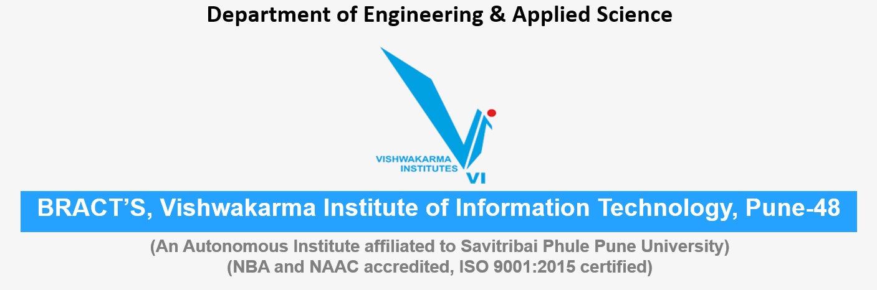
Air pollution Pune city Energy , Water , Environment Sustainability
Roll No. | PRN | Name of student | Div. | VIIT email ID
1405 | 22110075 | Yash Gavit | N | yash.22110075@viit.ac.in
1412 | 22110206 | Prasad Nathe | N | prasad.22110206@viit.ac.in
1418 | 22110305 | Sahil Savardekar | N | sahil.22110350@viit.ac.in
1421 | 22110398 | Siddhesh Khairnar | N | siddhesh.22110398@viit.ac.in

Slide 2
Index
1. | What is air pollution ?
2. | Causes of air pollution.
3. | Effect of air pollution.
4. | Remedial measures to control air pollution.
5. | Pune air pollution case study.
7. | Measure taken at the individual level.
8. | Wrap up and related Outcomes
9. | References.

Slide 3

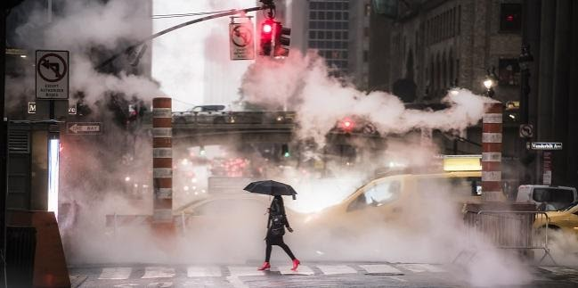
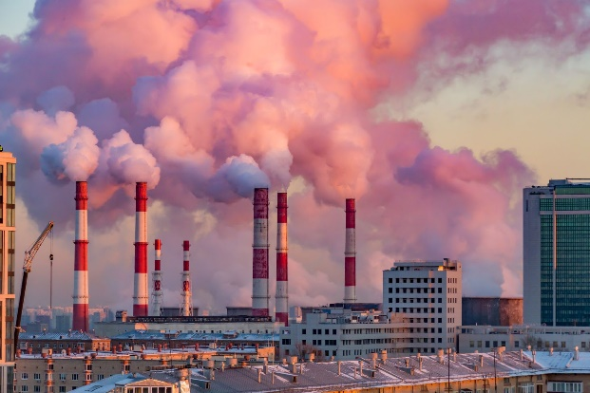
What is Air Pollution ?
Air pollution is caused by solid and liquid particles and certain gases that are suspended in the air. These particles and gases can come from car and truck exhaust, factories, dust, pollen, mold spores, volcanoes and wildfires. The solid and liquid particles suspended in our air are called aerosols.
Air pollutants are classified into two types: Primary pollutants and secondary pollutants.

Slide 4
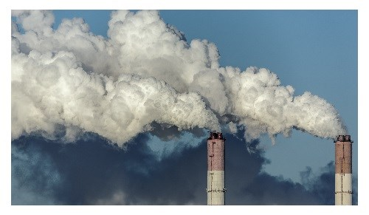
Causes of Air Pollution
When particles in the air combine with ozone, they create smog. Smog is a type of air pollution that looks like smoky fog and makes it difficult to see.
Combustion of fossil fuels, like coal and oil for electricity and road transport, producing air pollutants like nitrogen and sulfur dioxide
Emissions from industries and factories, releasing large amount of carbon monoxide, hydrocarbon, chemicals and organic compounds into the air
Agricultural activities, due to the use of pesticides, insecticides, and fertilizers that emit harmful chemicals

Slide 5
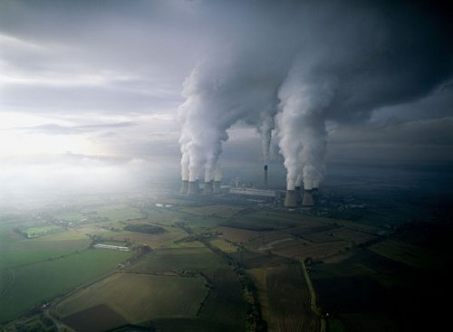
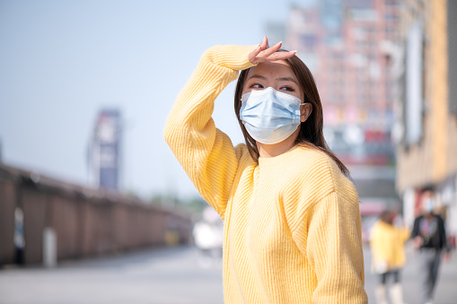
Effects of Air Pollution
Acid rain is caused by a chemical reaction that begins when compounds like sulfur dioxide and nitrogen oxides are released into the air. These substances can rise very high into the atmosphere, where they mix and react with water, oxygen, and other chemicals to form more acidic pollutants, known as acid rain.
Haze is caused when sunlight encounters tiny pollution particles in the air. Haze obscures the clarity, colour, texture etc
Air pollution effects on animals can be severe. Pollution affects the lungs of many different types of the animal by causing cancer, respiratory problems, and acute effects like asthma. Animals may also develop heart diseases or even brain damage that could lead to neurological disorders.
The hole in the ozone layer is caused by air pollutants. Chemicals used as refrigerants, such as chlorofluorocarbons (CFCs), contain chlorine atoms. Releasing chlorine atoms into the atmosphere destroys ozone. A single chlorine atom can destroy thousands of ozone molecules.

Slide 6

Remedial Measures to control Air Pollution
Designated Bodies for Environmental Concern and Policy Implementation:
The Ministry of Environment and Forests
Department of Environment of the Government of National Capital Territory
Central Pollution Control Board ( CPCB )

Slide 7
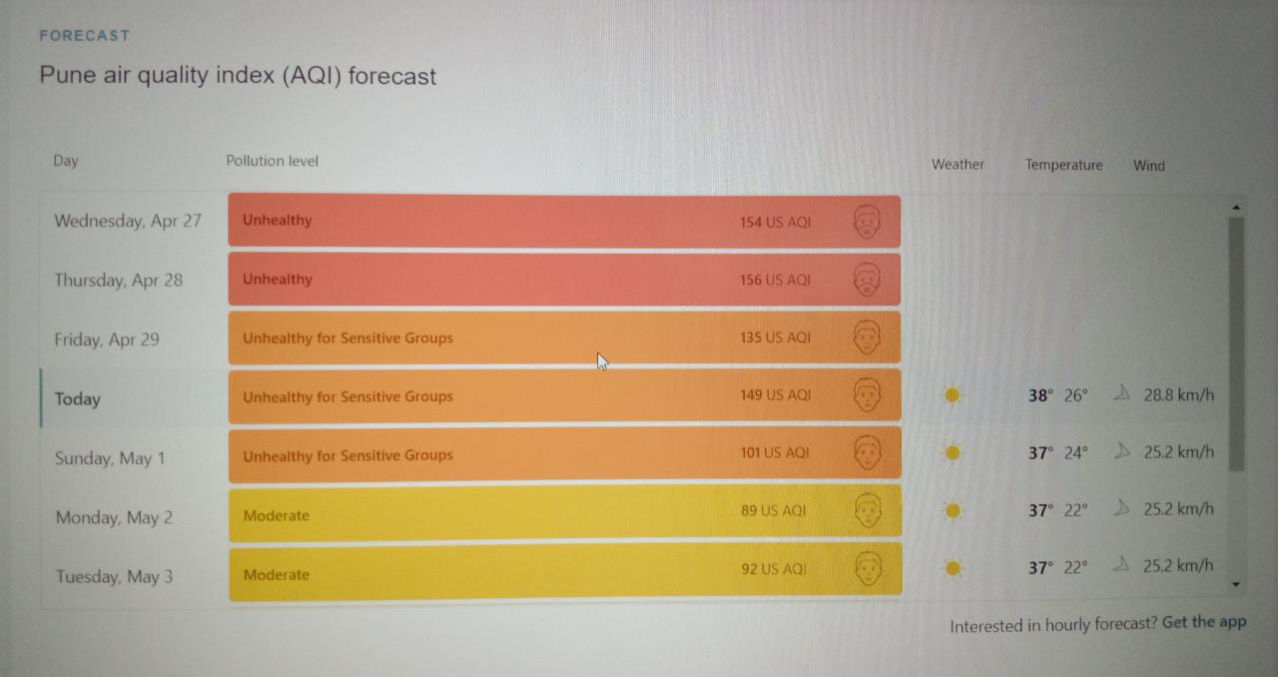
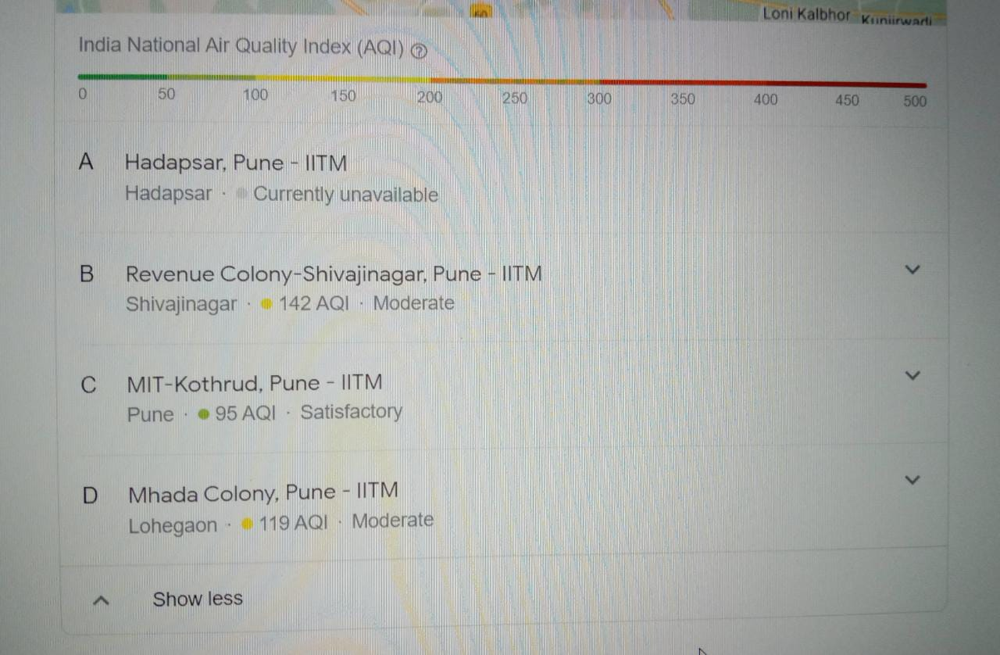
Pune Air Pollution Case Study

Slide 8
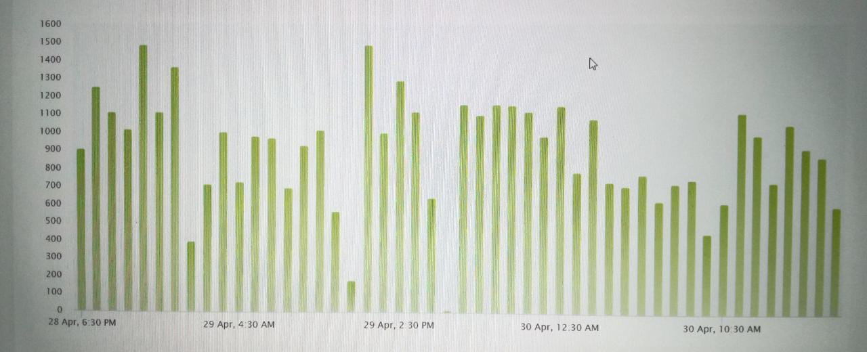
Historic air quality graph for Pune showing CO level

Slide 9
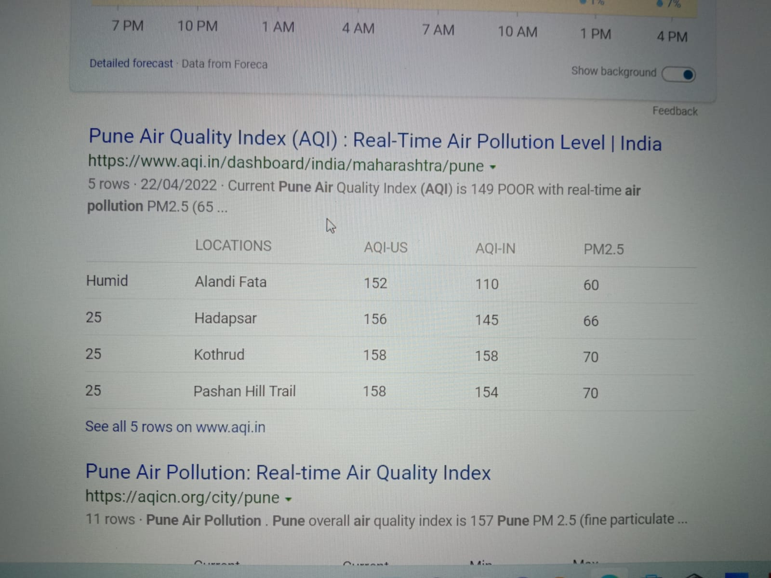
Effects
Respiratory and Heart Problems
The effects of air pollution are alarming. They are known to create several respiratory and heart conditions like asthma, chronic bronchitis, emphysema, heart attacks and strokes along with cancer, among other threats to the body. Several million are known to have died due to the direct or indirect effects of Air pollution.
Due to low air quality airport get effect.

Slide 10
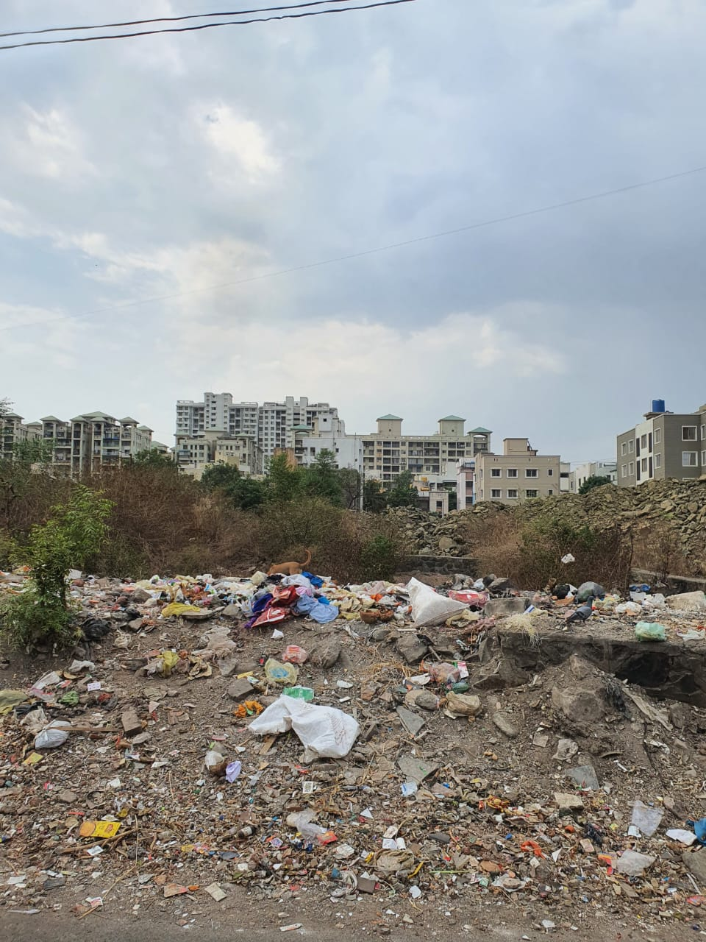
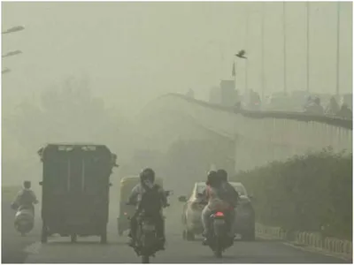
Pictures of air pollution

Slide 11
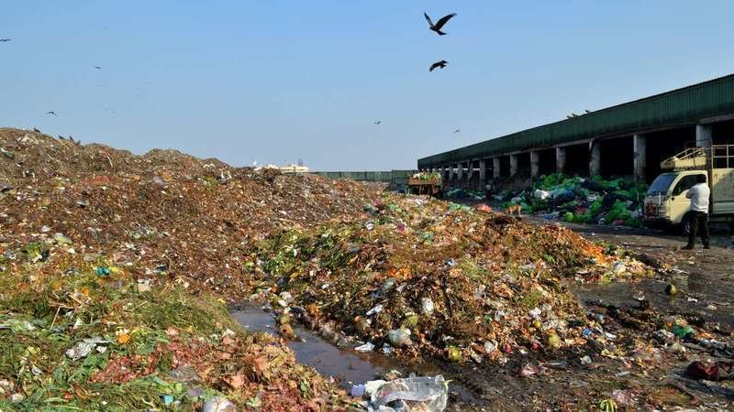
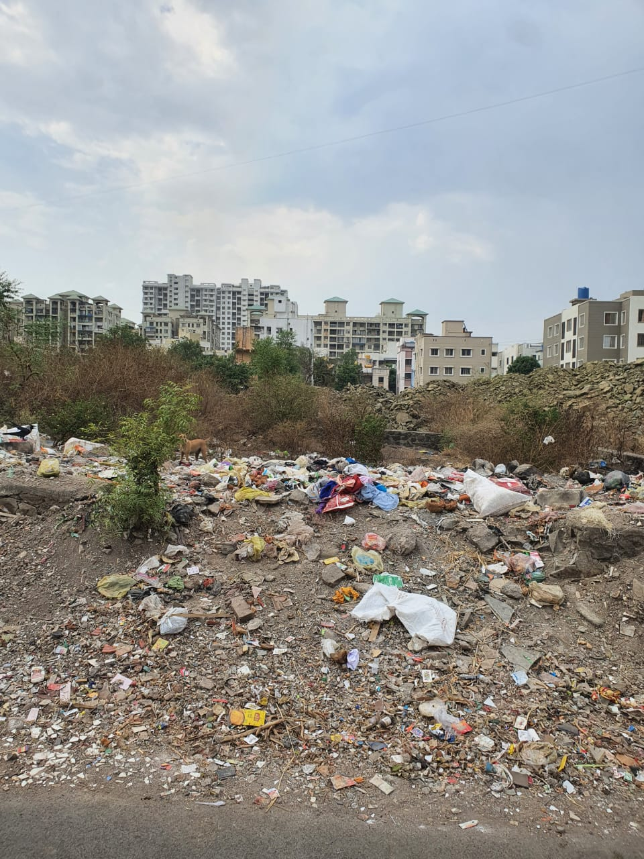

Slide 12

Measures taken At Individual level:
Use of public transport
Reduce reuse and recycle products bought by yourself.
Reduction in the use of plastic bags
No smoking areas
Use of filers for chimneys and use of proper equipment in industries to control air pollution
Avoid usage of crackers even during festivals
Afforestation
Use mask for self protection.

Slide 13

Wrap up and related Outcomes
We must start using metro, bus, or any public transport .
Plantation of tree is required in pune. As there less amount of tree.
We have to focus on air quality index. As it is important to maintain quality of air.

Slide 14
References
https://www.iqair.com/in-en/india/maharashtra/pune
https://www.conserve-energy-future.com/causes-effects-solutions-of-air-pollution.php
https://app.cpcbccr.com/AQI_India/
https://timesofindia.indiatimes.com/city/pune/pollution-news
https://www.nrdc.org/sites/default/files/media-uploads/pune_airpollution_ib.pd

Slide 15

15

